Slide 1
Project Presentation of Company Oriented Project (COOP)
On
UPI - Payments Plug-in, APIs
Rishabh Jain
2110992075
Supervised By
Sahil Bansal Product Manager
Department of Computer Science and Engineering,
Chitkara University, Punjab

Slide 2
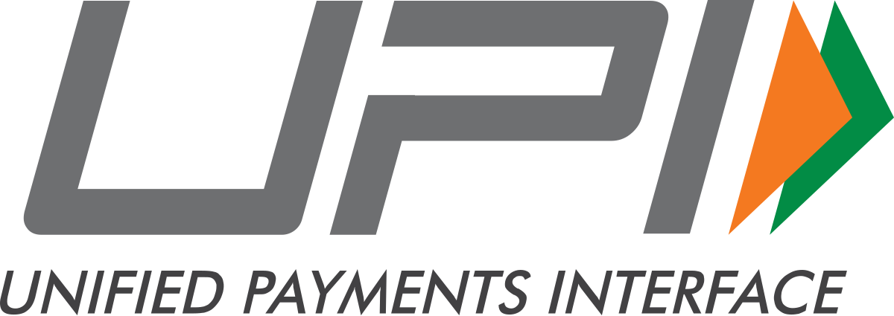
What is UPI?
“Unified Payments Interface (UPI) is a system that powers multiple bank accounts into a single mobile application (of any participating bank), merging several banking features, seamless fund routing & merchant payments into one hood. It also caters to the “Peer to Peer” collect request which can be scheduled and paid as per requirement and convenience.”
- By NPCI (National Payments Corporation of India)
It is built on Immediate Payment Service (IMPS) infrastructure, ensuring quick and seamless transactions.
UPI allows users to link multiple bank accounts from different banks into one app for unified access.
Designed primarily for mobile devices, making digital payments convenient and accessible.
It plays a central role in India's growing digital economy by enabling cashless and contactless payments.
‹#›

Slide 3
Why UPI?
UPI eliminates the complexity of traditional banking by allowing money transfers using simple identifiers like a mobile number, QR code, or VPA. No need for lengthy bank account details or visiting ATMs.
Unlike credit cards or payment gateways, which often have transaction fees, most UPI transactions are free or come with minimal charges. This cost-effectiveness benefits both users and small businesses.
Traditional banking methods like NEFT or cheques can take hours or days for settlement, but UPI processes payments instantly, making it ideal for urgent transactions.
UPI employs two-factor authentication, including your registered mobile device and a unique MPIN (Mobile PIN), ensuring transactions are highly secure against fraud or unauthorized access.
UPI bridges the gap between urban and rural areas, enabling even small vendors and individuals without access to complex financial systems to participate in the digital economy.
‹#›

Slide 4
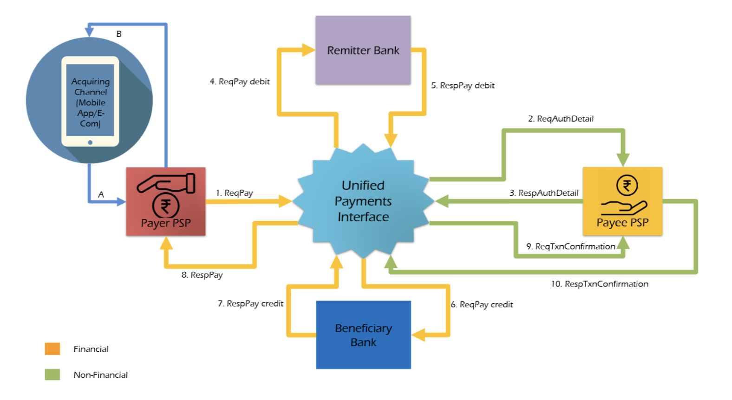
How UPI works?
UPI offers 2 varieties of transactions i.e. P2P and P2M ~ Peer-to-Peer and Peer-to-Merchant
For every real-time transaction, certain parties are involved and that’s why it’s also referred to as the 4 Party Model, the models are:
Payer – The person who is initiating the payment Payee – The person who receives the payment Beneficiary Bank – Involvement of receiver’s bank account Remitter Bank – Involvement of Payer’s Bank and attached account
‹#›

Slide 5
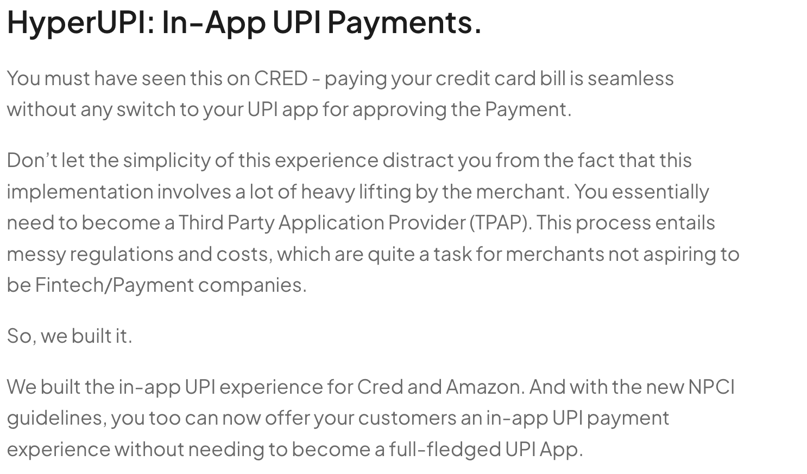
What is Hyper-UPI : UPI Plugin?
A UPI (Unified Payments Interface) plugin is a software module or SDK (Software Development Kit) that integrates UPI payment functionalities into applications or platforms, enabling seamless real-time payment capabilities.
It simplifies the process of embedding UPI payment options into mobile or web applications, allowing businesses and developers to offer a convenient and secure payment method to their users.
Enables merchants or platforms to initiate, verify, and complete UPI-based transactions directly within their apps without requiring users to switch to external payment apps.
UPI plugins come with robust encryption and fraud detection mechanisms, ensuring that sensitive data like account numbers and UPI PINs remain secure during transactions.
Reduces development effort by providing ready-to-use libraries or SDKs.Enhances business growth by integrating a trusted and widely used payment system, increasing the likelihood of transaction success.
-By Juspay Technologies
‹#›

Slide 6
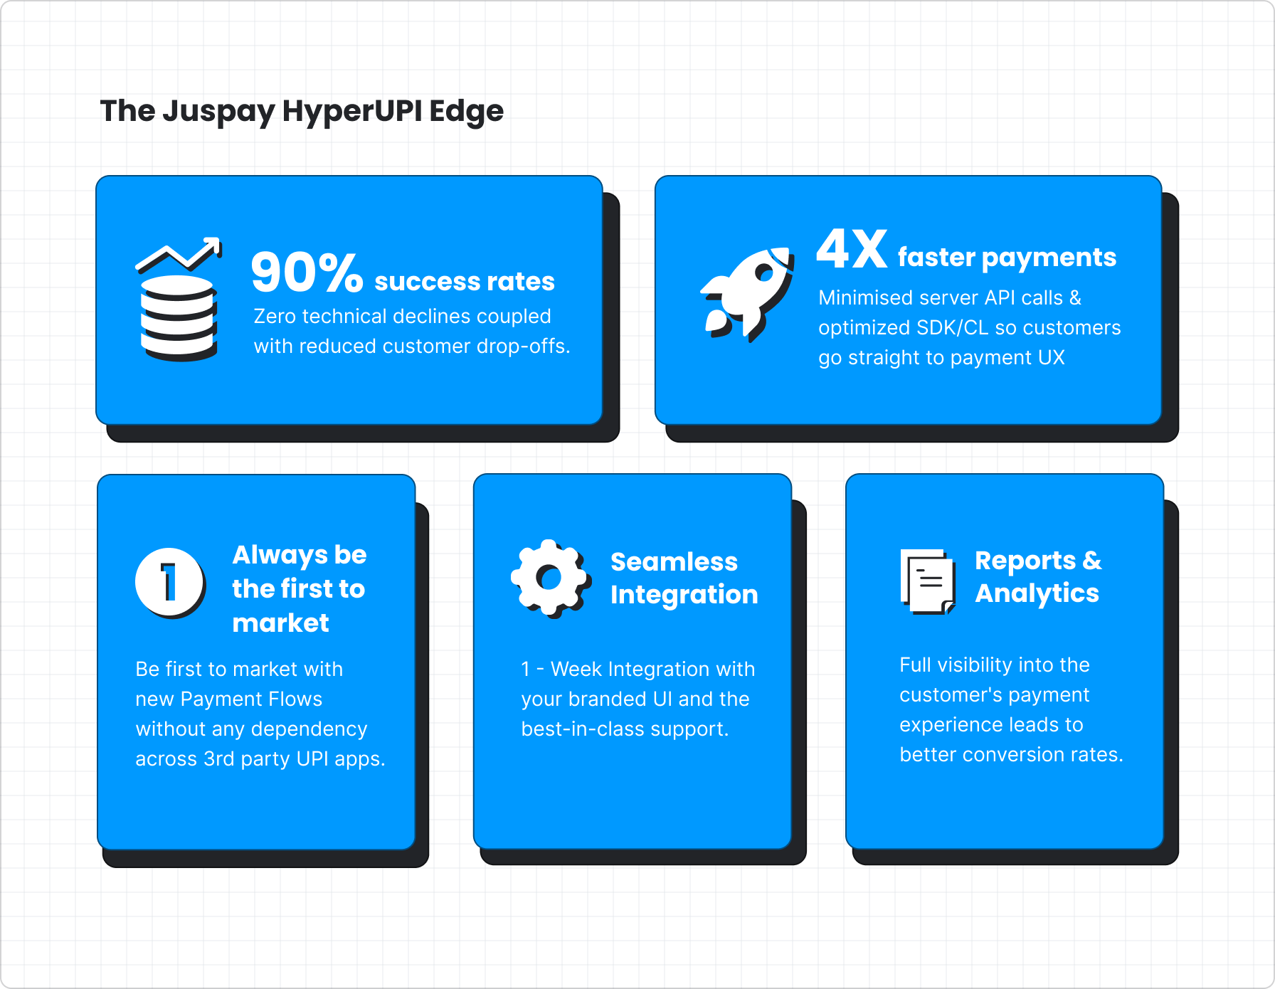
Why Hyper-UPI?
In-App UPI Payments mean an Exceptional Customer Experience & Payment Conversions for merchants.
Better Customer Experience: Embedded or In-App UPI Payments lead to frictionless customer experiences. Embedded Payments also allow for better visibility over the entire customer purchase funnel.
Higher Conversions: No Additional hops to third-party UPI Apps mean merchants can now enable UPI for customers on their app and provide an unbroken experience. This Frictionless state leads to better conversions and, ultimately, better retention owing to a simple and seamless payments experience.
Lesser Drop Offs: A two-step process leaves less room for customers to drop-offs compared to the 6-step process in UPI Intent. Zero redirections to external apps reduce the scope of non-technical errors.
Higher Success Rates: 90% + Success Rates with lesser drop-offs and a seamless in-app process.
Better Customer Insights: In-App UPI Payments allow greater depth of visibility on the entire customer journey. You can understand why and where customers drop off and accordingly retarget them.
‹#›

Slide 7
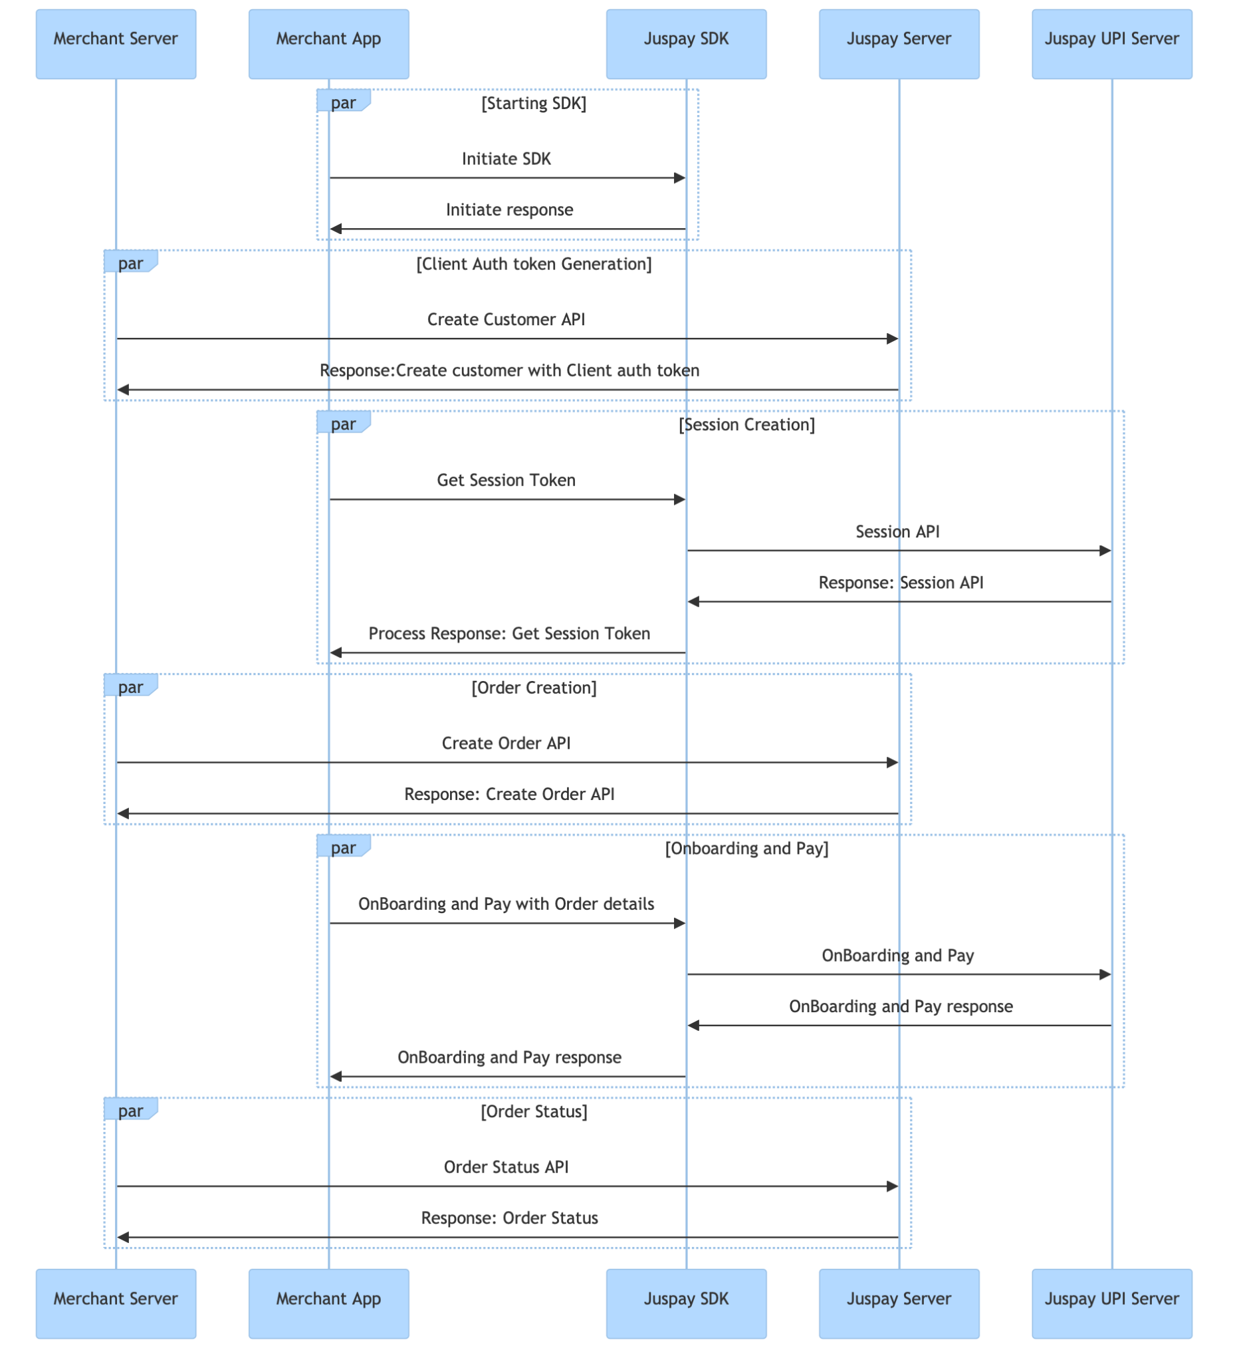
HYPER-UPI Flow
Integration Architecture - Clientauth Token Flow
‹#›

Slide 8
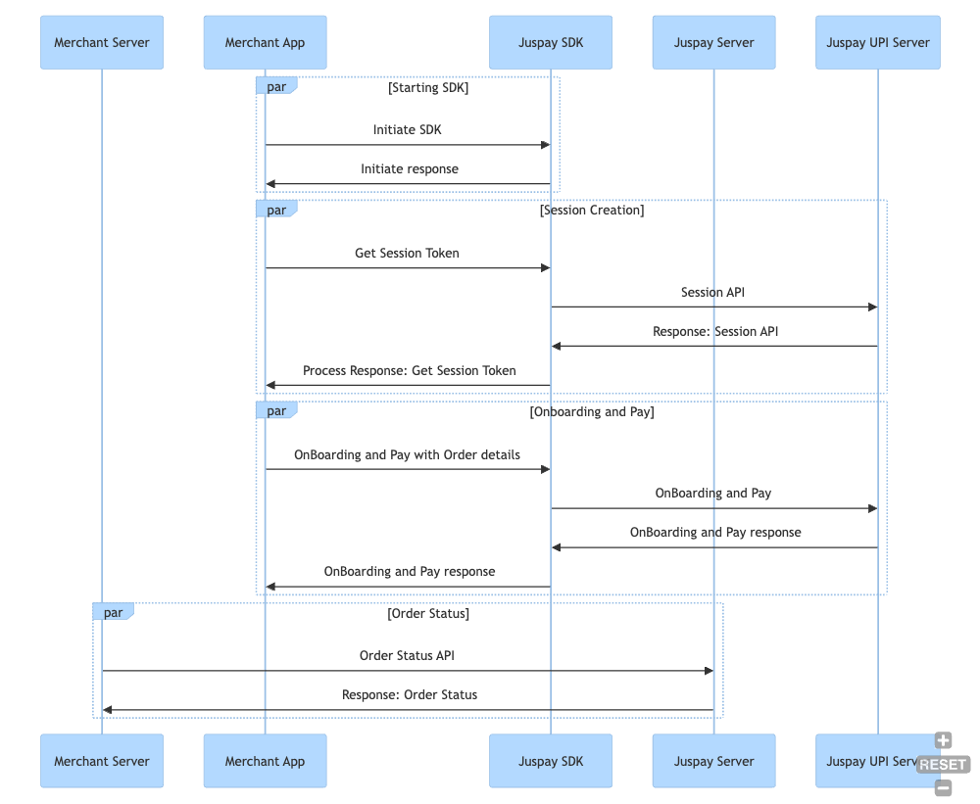
HYPER-UPI Flow
Integration Architecture - Signature Flow
‹#›

Slide 9
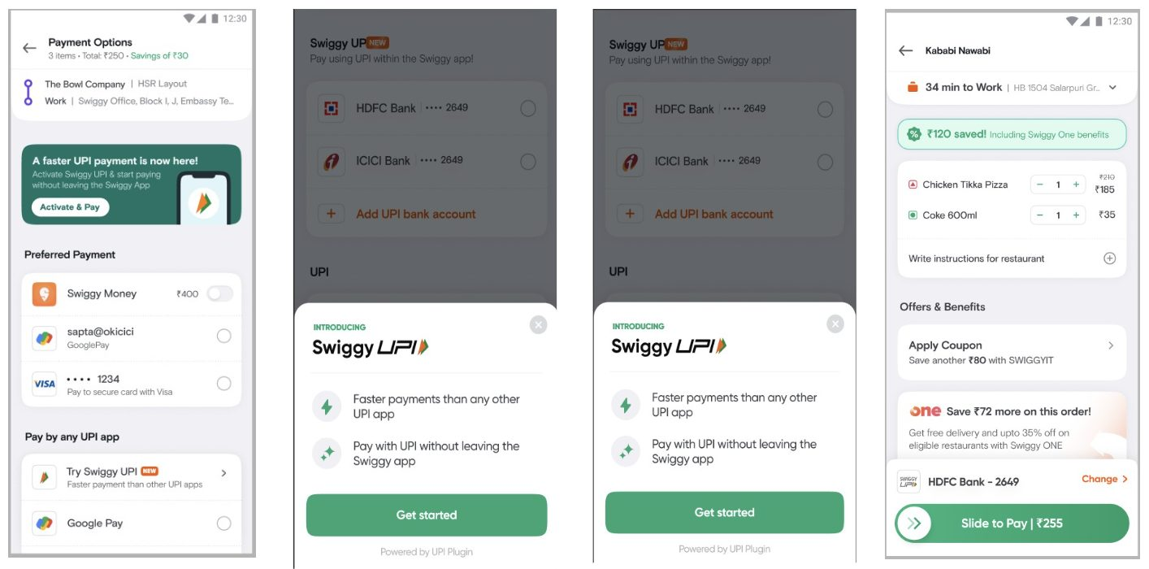
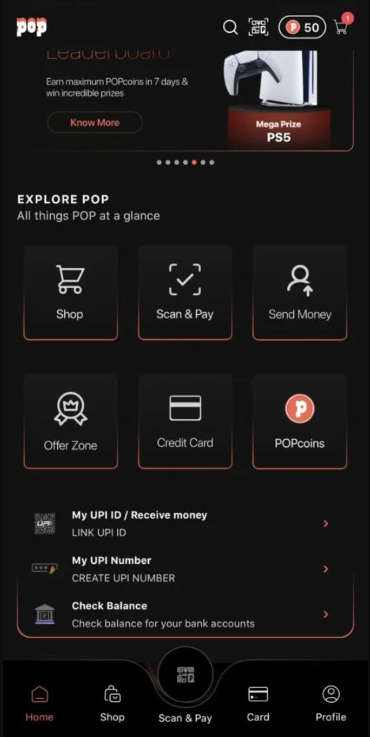
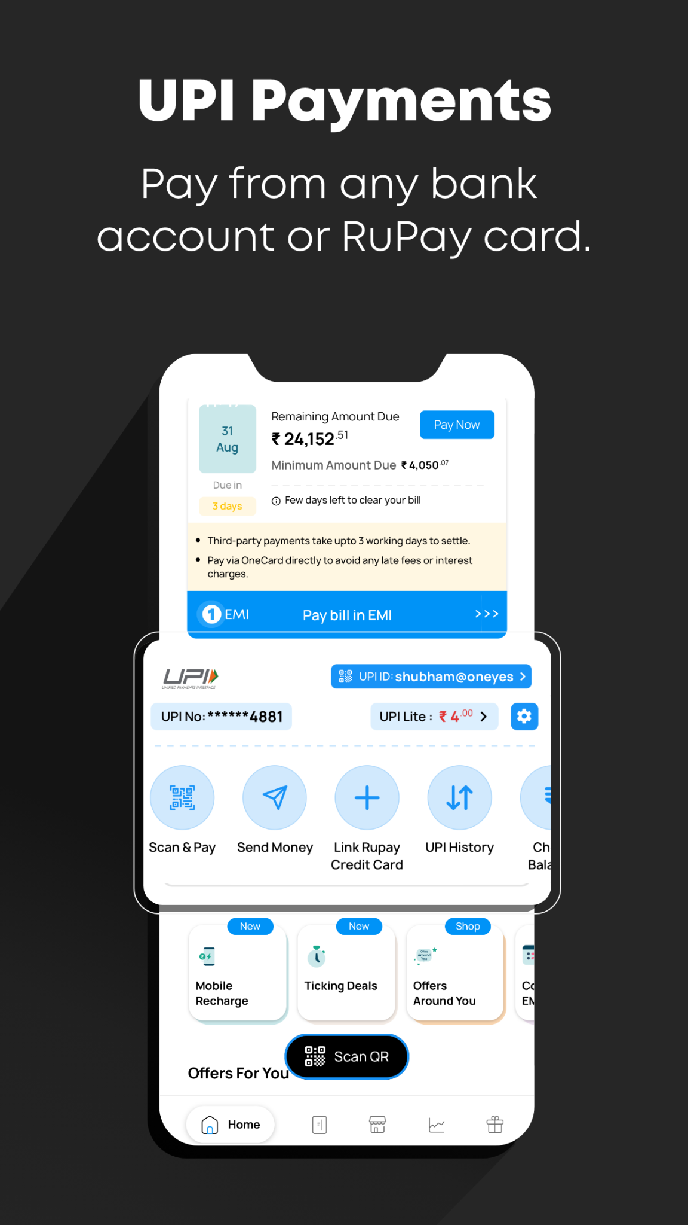
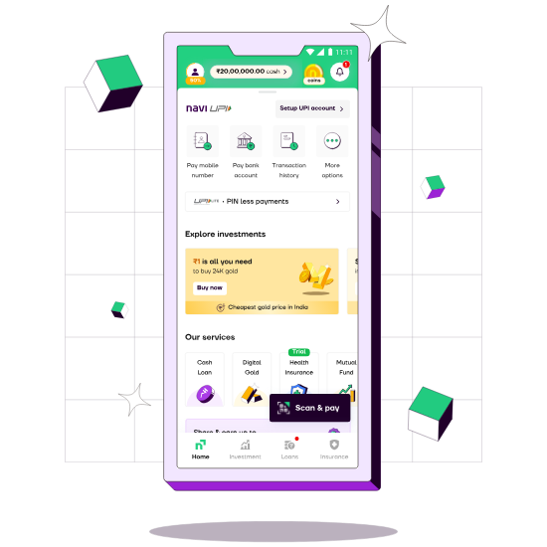
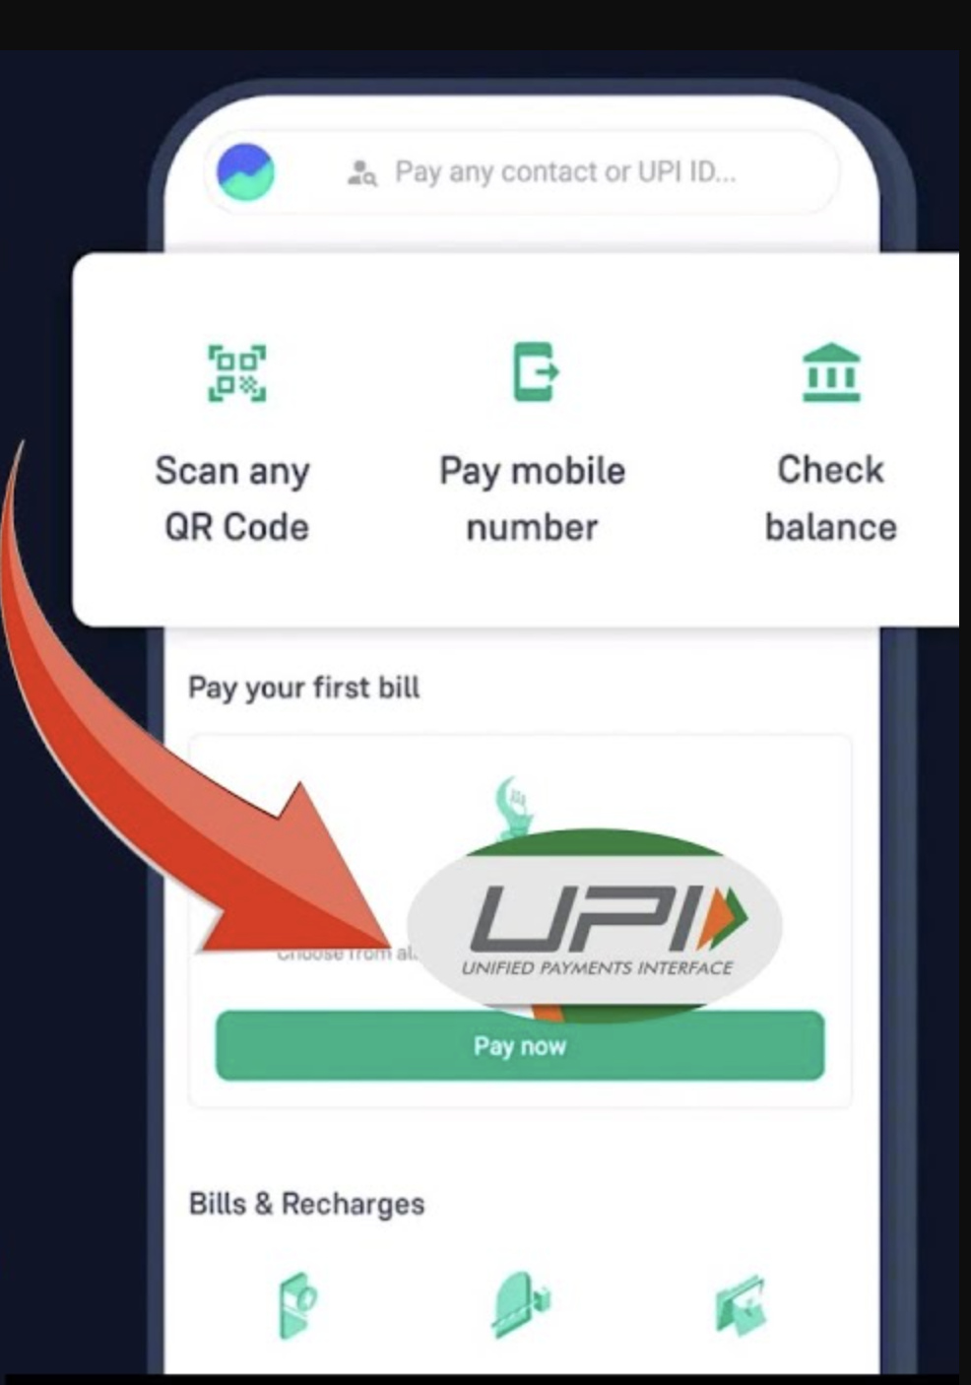
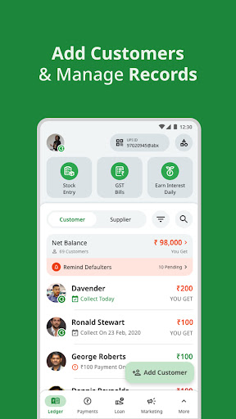
Hyper-UPI
‹#›

Slide 10
Thank You
‹#›

